Slide 1

MAJOR PROJECT FACE MASK DETECTION USING CNN
BY
VIKASH KUMAR DIWAKAR
AI/ML INTERN, SCIFOR TECHNOLOGY

Slide 2
OBJECTIVE
Detect whether a person is wearing a face mask in real-time or from images using deep learning.
Ensures safety in public places by automating mask compliance checks during the COVID-19 pandemic.

Slide 3
Introduction
In the wake of the global COVID-19 pandemic, face masks have become a crucial element in safeguarding public health. Detecting whether individuals are wearing masks, particularly in crowded or high-traffic areas, presents a significant challenge. This project focuses on developing an automated face mask detection system that leverages advanced machine learning techniques to accurately identify whether a person is wearing a mask. By integrating computer vision with deep learning algorithms, our system aims to enhance public safety and compliance with health regulations.

Slide 4
Problem Statement
The problem addressed in this project is the development of an automated face mask detection system that can accurately and efficiently identify whether individuals are wearing masks in real-time.

Slide 5




OVERVIEW OF ANALYSIS
Data Cleaning
Data Exploration
Predictive Modeling
Understand the structure of the dataset and clean data before analysis
Uncover initial patterns, characteristics, and points of interest using visual exploration
Formulate a statistical model to forecast an outcome using relevant predictors

Slide 6
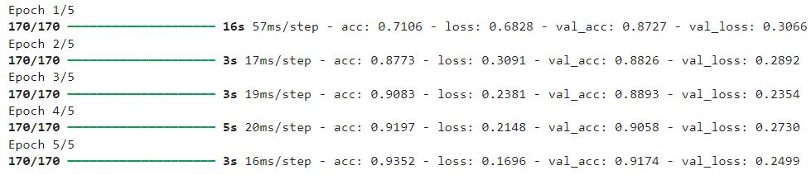
MONITORING MODEL

Slide 7
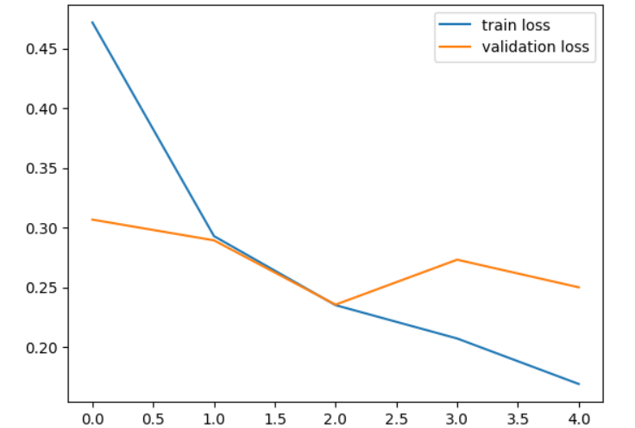
LOSS
Surprizingly only one-forth restaurants has online delivery facility.

Slide 8
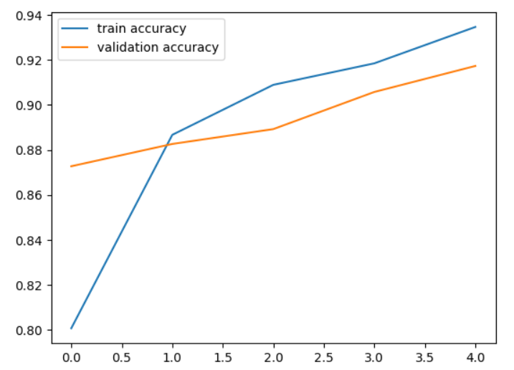
ACCURACY

Slide 9
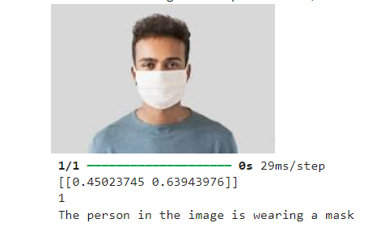
TESTING WITH MASK
New Delhi has more than 5000 restaurants.
All top 5 cities are from North India.

Slide 10
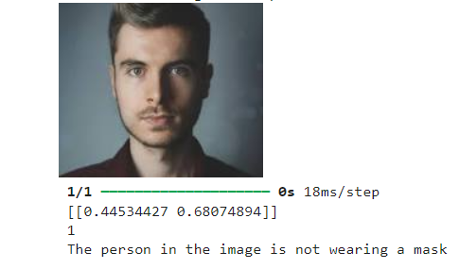
TESTING WITHOUT MASK

Slide 11
Challenges
Reading the dataset and comprehending the problem statement.
Examining the business KPIs for app development and devising a solution to the problem.
Handling the error, duplicate and null values in the dataset.
Designing multiple visualizations to summarize the information in the dataset and successfully communicate the results and trends to the reader.

Slide 12
Conclusion
Training Accuracy -93.52%
Testing Accuracy – 91.3%

Slide 13

.
.

